Slide 1


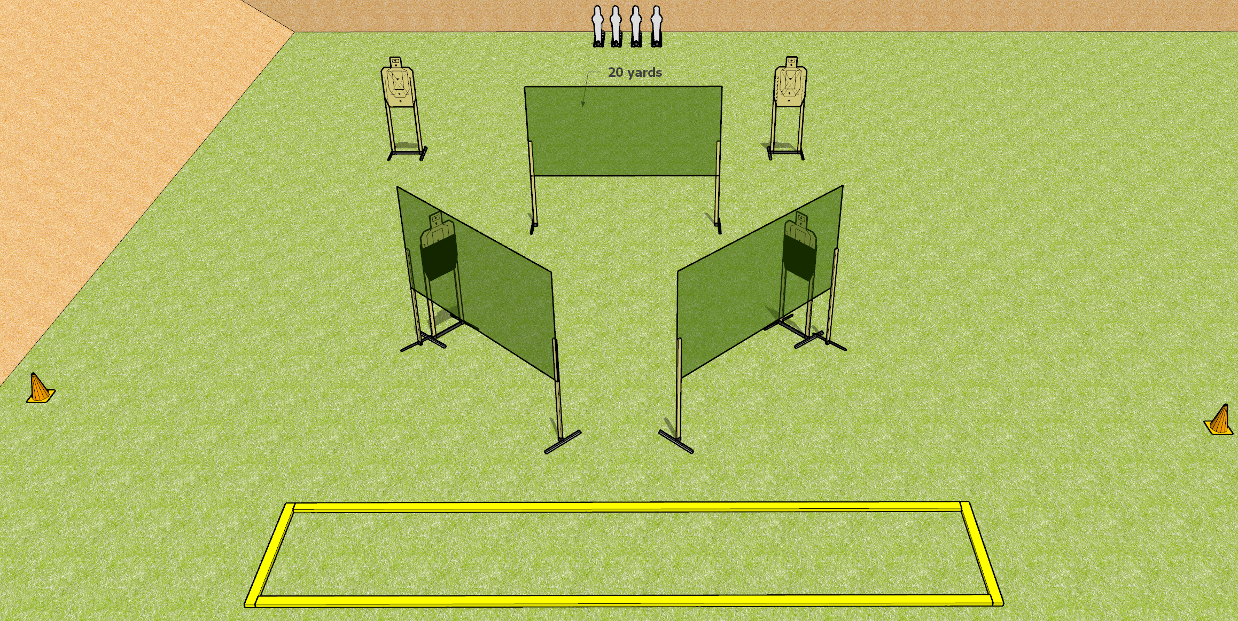
 | Dothan Gun Club – USPSA Match Side to Side Course Designer : Drew Coleman
START POSITION : Standing inside the shooting area, facing up range, toes touching the rear fault line, wrists above shoulders. PCC buttstock on belt pointed at either orange cone.
GUN READY CONDITION : Pistol loaded and holstered. PCC loaded, buttstock on belt, safety on, pointed at orange cone. |  | SCORING: Comstock, 12 rounds TARGETS: 4 paper, 4 Steel SCORED HITS: Best 2 on paper, steel until down START-STOP: Audible, last shot RULES:
STAGE PROCEDURE: Engage targets as they become available from within the fault lines.

Slide 2
Side to Side
Written Stage Briefing
Side to Side is a 12 round, 60 point, Comstock Short Course. There are four USPSA targets and four mini poppers. The best two hits on paper will score, and steel must fall to score. The start signal is audible.
Handgun start position is standing in the shooting area facing uprange, wrists above respective shoulders, toes touching rear fault line. Handgun is loaded and holstered.
PCC start position is standing in shooting area with buttstock on belt, muzzle generally pointed at either orange cone. Carbine is loaded, safety on, held with both hands.
Upon start signal, engage targets as they become available from within the shooting area.

